Slide 1
Sane PowerShell Script Design
October 2024
Chris Arceneaux
Senior Solutions Architect
David Domask
Principal Analyst, Product Management

Slide 2



Smart PowerShell Design Tricks
October 2024
Chris Arceneaux
Senior Solutions Architect
David Domask
Principal Analyst: Product Management
Notes:
Introduce ourselves and our PowerShell background.

Slide 3
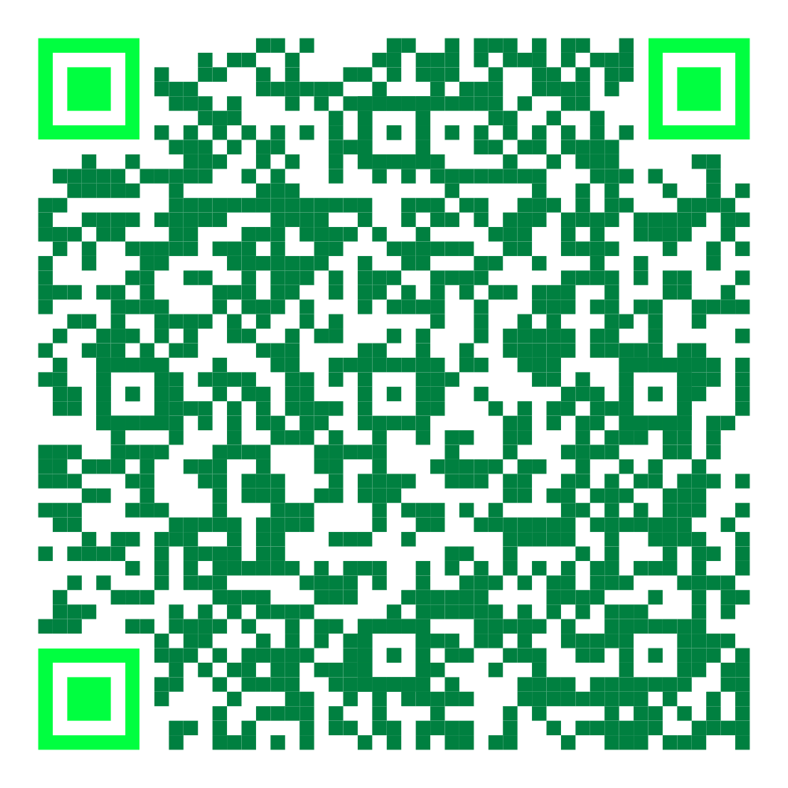
Github Repo Link
Follow along with a copy of the presentation and the example script
https://github.com/ddomask/v100-summit-berlin2024-powershell-deepdive

Slide 4
ALL GREEN CONTENT

Slide 5
Agenda
Useful PowerShell commands
Script design tips
PowerShell in action

Slide 6
Useful PowerShell commands

Slide 7
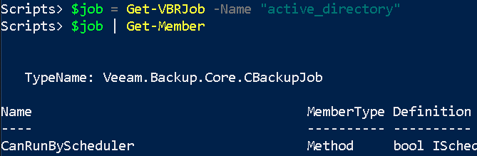
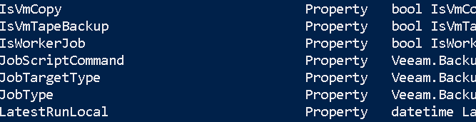
Get-Member
TypeName: Object type Method: Performs an action and returns result Property: Provides access to additional metrics
Notes:
PowerShell discovery tool
Methods to retrieve additional data can be highly useful
While possible, I do not recommend using methods to make changes. Especially in a production environment.

Slide 8
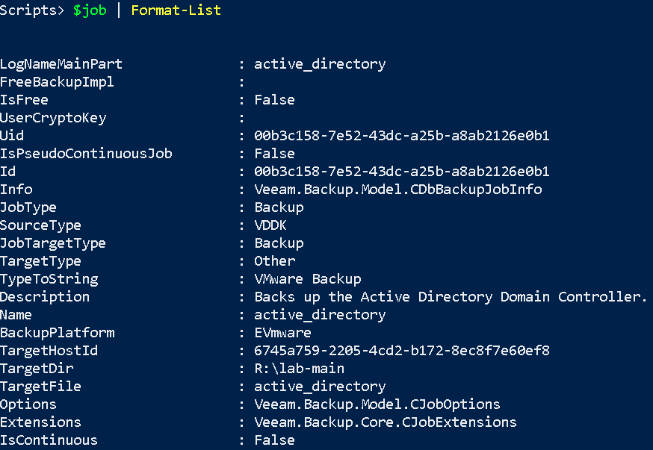
Format-List
Forces PowerShell to return list of all top-level properties.

Slide 9
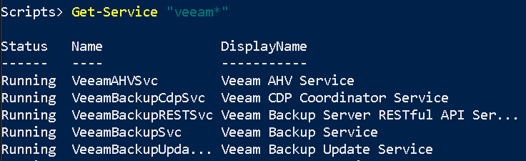
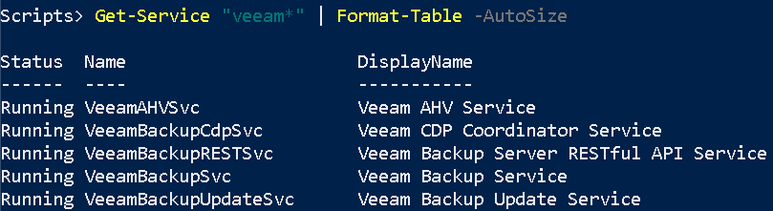
Format-Table
Forces PowerShell to return table.
-Autosize flag forces columns to resize according to data size.

Slide 10
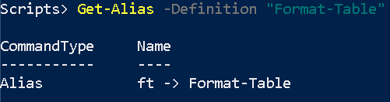
Get-Alias
Knowing an alias can optimize your PowerShell experience.
Pro tip: You can create your own aliases!
Many more are available!

Slide 11
Script design tips

Slide 12
Idea…
Why focus on design before writing code?
Design focuses on business logic, code is then written according to design
Initial design can be written into script help section
Description
Parameters
Output
Parameter tips & best practice
Functions
Error handling
Logging
Standard logging
Verbose logging – helps greatly when debugging

Slide 13
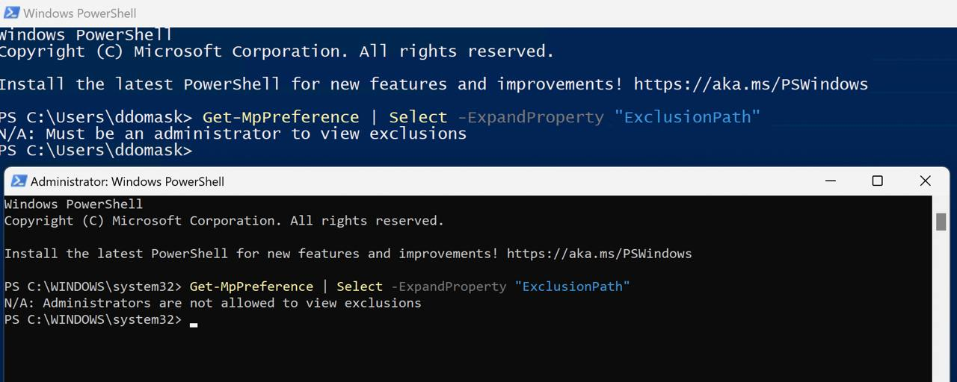
Why?
- Limited User Knowledge in Powershell
- Security Hardening in Powershell introduces confusing errors
- Troubleshooting scripts is time-consuming

Slide 14
Script Design Tips and Tricks

Slide 15
Parameters
https://learn.microsoft.com/en-us/powershell/module/microsoft.powershell.core/about/about_functions_advanced_parameters?view=powershell-7.4 (Search “Powershell About Advanced Parameters”)
Instructs what user can change in script processing
Business logic defines parameters
Interactive vs unattended scripts
Avoid String input
Script and Presentation

Slide 16
A simple parameter refresher
param(
[switch]$AllEventLogs,
[switch]$ExtendedEventLogs,
[string]$ExportPath
)
Two switches (Boolean) control same operation
String Input
This will result in a lot of PEBKAC and validation errors!
Notes:
From our public troubleshooting script TapeDiagCollector.ps1
It’s unclear when to use Extended vs All logs
Handling for the switches requires switch or if/then statements to validate user intention
We need to ensure the ExportPath exists, we can write to it, and also ensure whatever we write doesn’t already exist

Slide 17
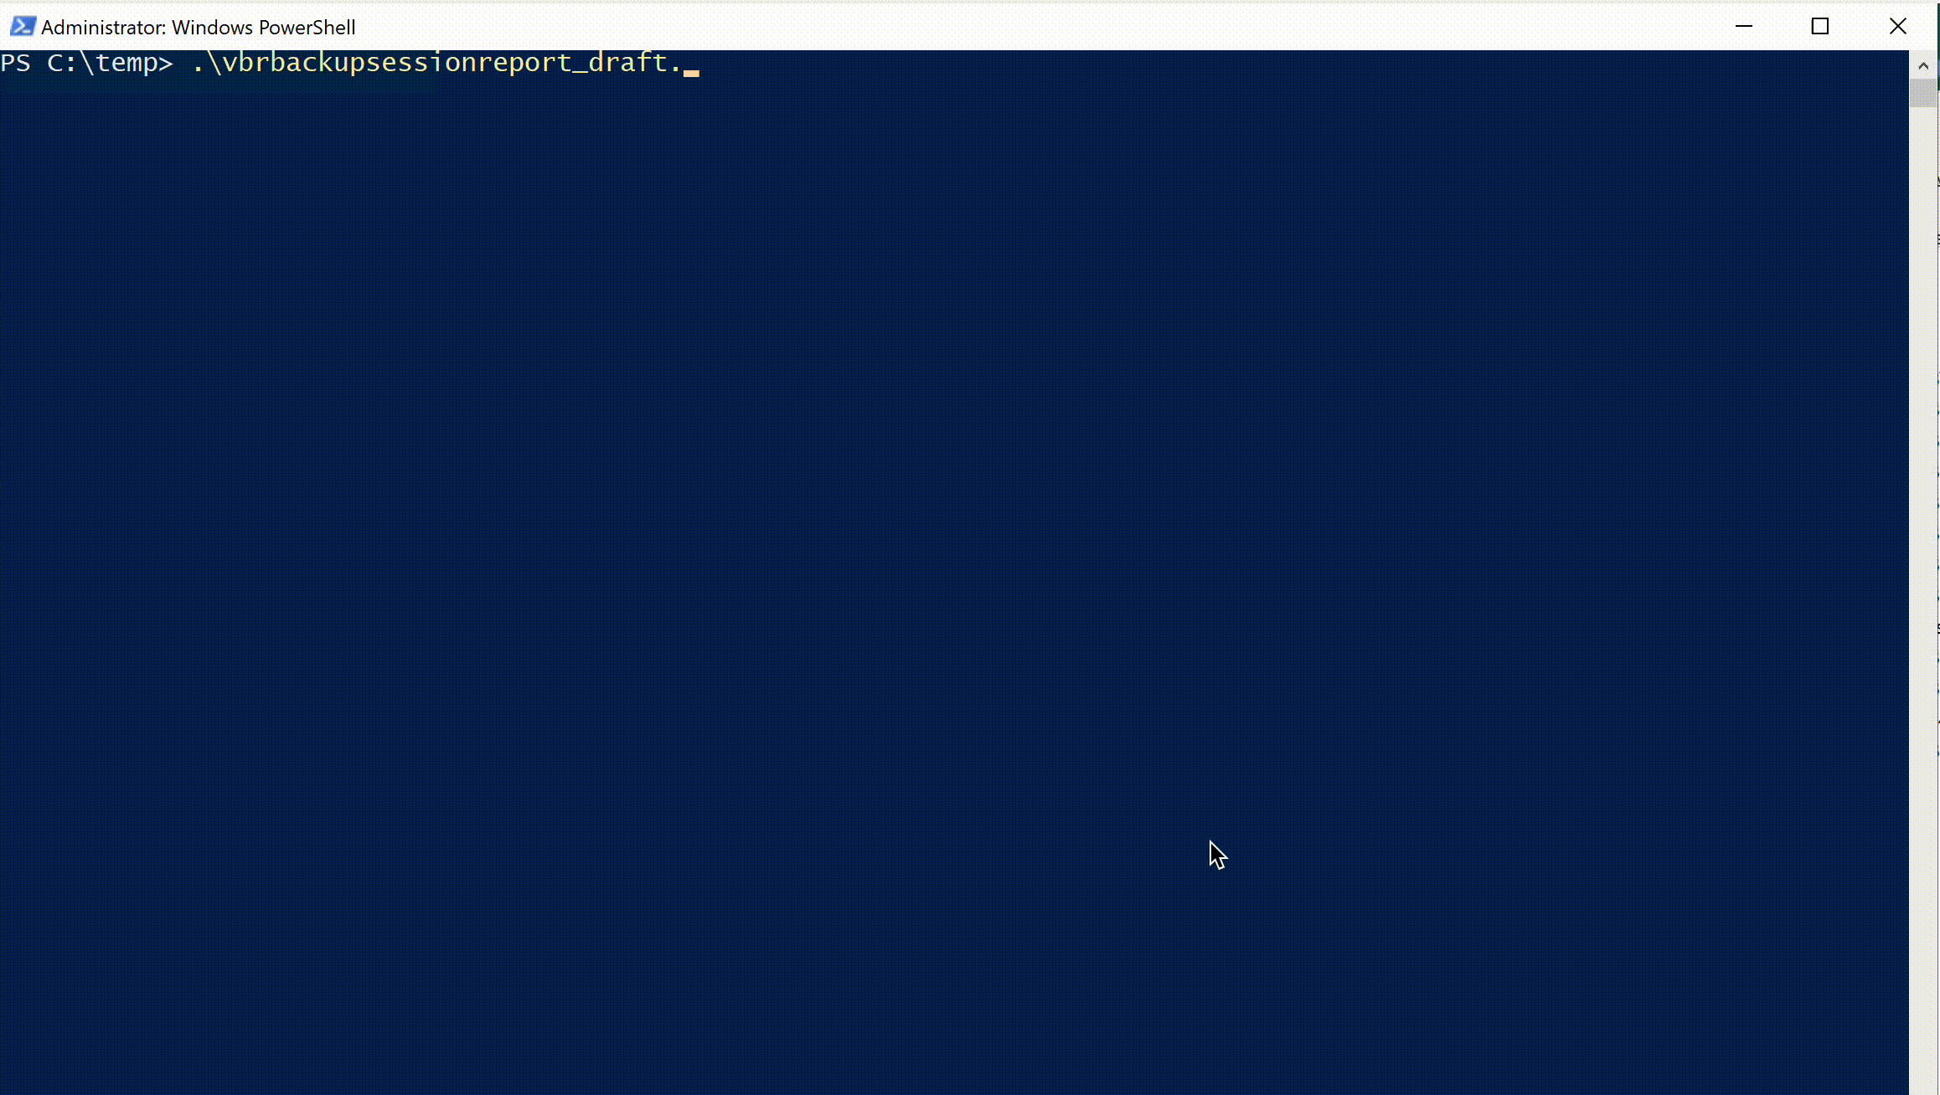
Business Logic Dictates Parameters, Not Vice-Versa
param(
[switch]$Last24H,
[switch]$Last7Days,
[switch]$AllTime,
[switch]$ExportToFile,
[string]$ExporType,
[String]$ExportPath,
[switch]$ExportCustomTimeRange,
[string]$StartTimeForExport,
[String]$endTimeForExport,
[string]$ReportName,
[switch]$IncludeAgents?,
[string]$RemoteVBRServerAddress,
[string]$RemoteVBRServerUsername,
[string]$RemoteVBRServerPassword,
[string]$DebugMode,
[string]$loggingPath
)
Notes:
Too many parameters, users will be reading the README doc for eternity and likely still will not understand what to do and when
Many overlapping parameters, doubling the work users and maintainers need to use/fix the script
Typos and poor parameter names (avoid questions)
Many parameters are “tacked on”, features implemented without considering what the script should do or what actually using it looks like

Slide 18
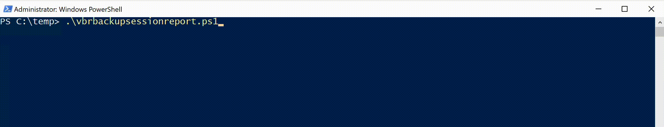
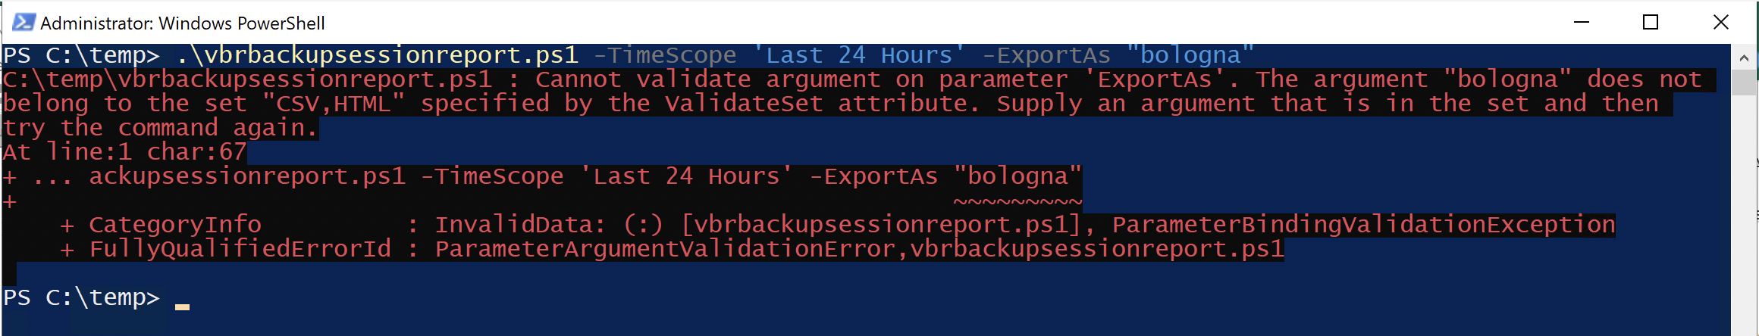
Let’s Pretty That Up
param(
[Parameter(Mandatory = $false)]
[ValidateSet("Last 24 Hours","Last 7 days","All Time")]
[string]$TimeScope,
[Parameter(Mandatory = $false)]
[ValidateSet('CSV','HTML')]
$ExportAs,
[Parameter(Mandatory = $false)]
[DateTime]$StartTime,
[Parameter(Mandatory = $false)]
[DateTime]$EndTime
)
Notes:
- Reduced options overall
Consolidated options that were of similar function, reducing the “choice panick” and less for us to document
Parameter names were updated to be more specific and give the user some idea of what they’re doing
By moving our presets into a validate set, we save ourselves the trouble of writing lots of IF/THENs, and can just use a SWITCH statement to determine the time range based on TimeScope

Slide 19
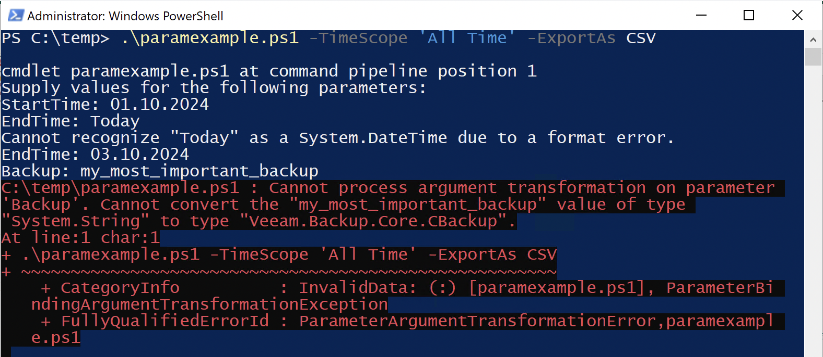
Validating Parameters
param(
[Parameter(Mandatory = $false), ParameterSetName = “Export”, Position = 0]
[ValidateSet("Last 24 Hours","Last 7 days","All Time")]
[string]$TimeScope,
Script and Presentation
Parameter Set – Define which parameters are shown to user
Flags:
Mandatory – Do we require this parameter?
ParameterSetName – Which other parameters must be used if this one is?
Position – order that the parameter must be set in
How Powershell wants you to do it
Notes:
While useful in some cases, overkill for most scripts and functions
Very restrictive, and the error handling is not great
Mandatory parameters are forced if the user does not provide it, but often cannot be meaningfully entered as many parameters require objects, which cannot be passed at this stage
Powershell by default will try to convert strings to the bound type, so we get ugly type conversion errors

Slide 20
Validating Parameters: Sanely
If($PSBoundParameters.Values.Count -eq 0 -and $args.count -eq 0) {
Get-Help $MyInvocation.MyCommand.Definition -Examples
Break
}elseif(-not($TimeScope) -And (-not($StartTime) -or -not($EndTime))){
$NoRangeError | word-wrap | Write-Host -ForegroundColor Yellow
Break
}
Telling users how to use the script
$PSBoundParameters – Variable that holds parameters passed
$args – Variable that holds undeclared parameters
$MyInvocation - Variable that holds information on the function/script being run
Notes:
Set at start of script so first thing we check is if the parameters are set
Return the Get-Help with –Example parameter if no parameters are set –AND no arguments are passed
We need to validate if $StartTime OR $EndTime are not present, and then act on that
This is much nicer as we can tell the user more about what they need to do rather than hope that they read it in the text powershell dumps on errors/with parameter handling

Slide 21
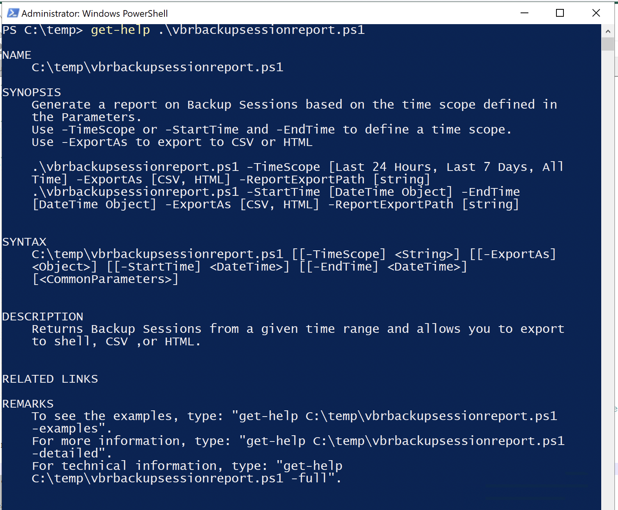
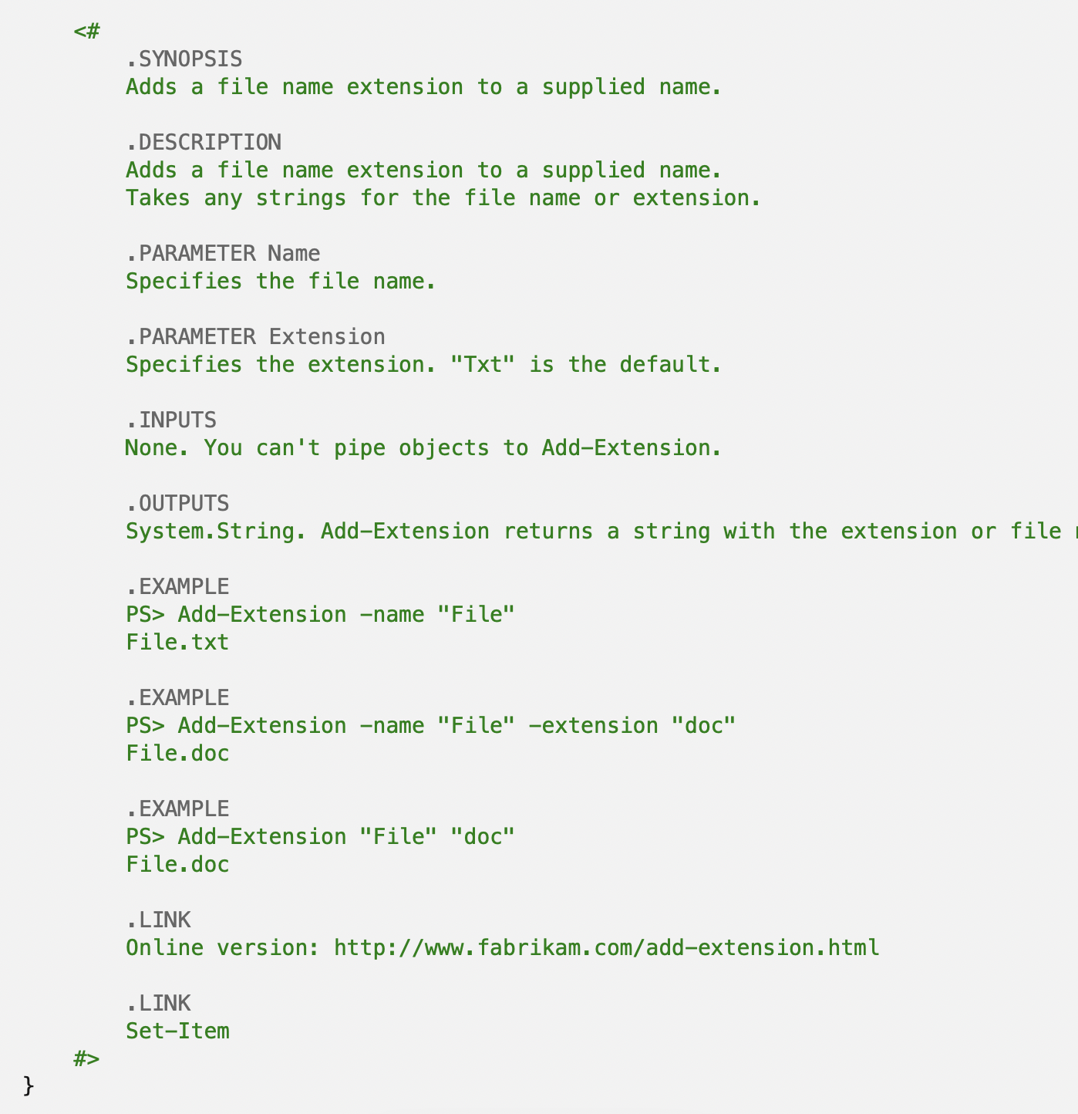
Comment Based Help
Tell your users how to use the script
https://learn.microsoft.com/en-us/powershell/scripting/developer/help/examples-of-comment-based-help?view=powershell-7.4
Search “Powershell Examples of Comment based help”
Notes:
Can define instructions/examples for each parameter
Provide Synopsis including syntax examples
Syntax is automatically generated from your parameters (Discuss parameter sets and dynamic parameters on next slide)
Can be part of a function OR at the start of a Script
Must be first entry in the script or the last entry. Pick ONE
If importing namespaces into the document (using the USING keyword), place the Help at the end of the document, or at the begining, and first line after the Comment Based Help must be your USING statement(s)

Slide 22
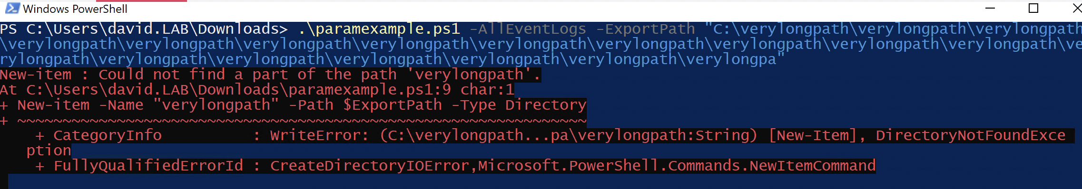
Strings Are the Devil
Too easy to face-roll keyboard
Path and name limitations require excessive checking in the script
Validation on [String] Parameters can be a pain
Ambiguity over what should be inputted (Is –Host parameter expecting Hostname or FQDN?)
Script and Presentation
Can you guess why this script failed to run?
Parse, don’t validate
Notes:
Validating strings is painful, users and the systems you work on will always be more creative than you are
Many systems “cheat” to get around their character limitations, so what users see is not necessarily what the underlying system has stored
Whenever possible, parse the information you need out, don’t validate strings (i.e., if you need to get a specific VBR job, think of how specific you can be _besides_ the name. UUIDs, additional properties or fields to parse from (e.g., Description), specific configurations
Get-VBRBackup and Get-VBRComputerBackup

Slide 23
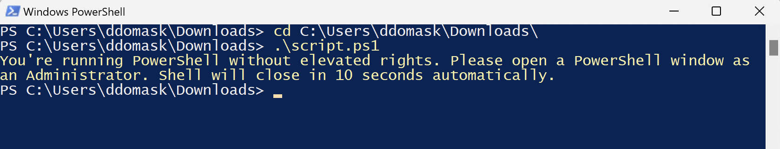
Script Sanity Checks
Tell users what is absolutely required for the script to successfully execute
Business logic defines what to check
Your users will love you for this

Slide 24
Example 1: Administrative Shell
if (-not(New-Object Security.Principal.WindowsPrincipal([Security.Principal.WindowsIdentity]::GetCurrent())).IsInRole([Security.Principal.WindowsBuiltInRole]::Administrator))
Fast and simple check
Many operations in Veeam will require administrator, so best to confirm and tell the user
It is NOT safe to assume users will guess/know this

Slide 25
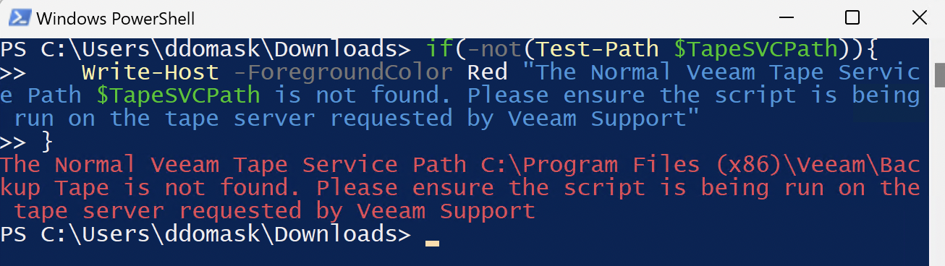
Another Example
Depends on script purpose and technology it will use
Checks allow you to tell the user what to do
What to check?
if(-not(Test-Path $TapeSVCPath)){
Write-Host -ForegroundColor Red "The Normal Veeam Tape Service Path $TapeSVCPath is not found. Please ensure the script is being run on the tape server requested by Veeam Support"
}
Notes:
Tape Diag Script
Used by Support tens of thousands of times
Script history (written because all the commands needed to troubleshoot were never run correctly)

Slide 26
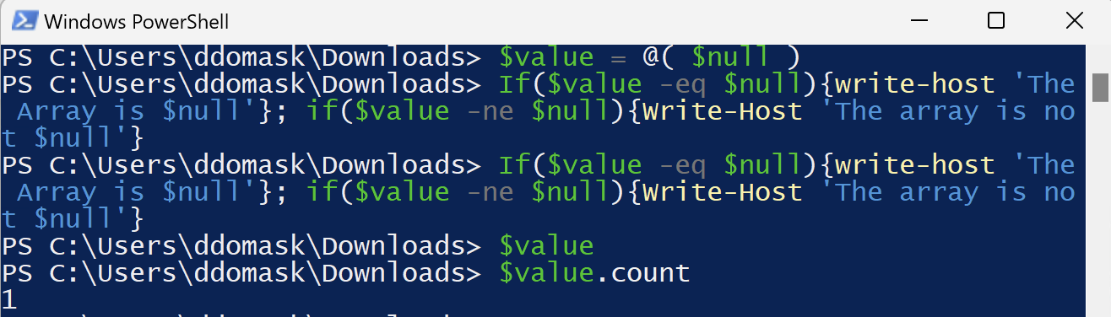
Common Sanity Tests
Item to check | Reason | cmdlet | Returned?
Directory or File exists | Check temp dir, Registry Key*, File, etc | Test-Path | Boolean
Item | Get files**, registry values, etc | Get-ChildItem | Object
Item Properties | Check item attributes (e.g., LastModifiedDate) | Get-ItemProperty | Object
Null-ness | Check if object is $null*** | $null –eq $object | Boolean
* Check existence of key, but not value. Use Get-ChildItem to get the value of a registry entry
** Get-ChildItem returns the item as an object, it does not return the contents. Use Get-Content for content
*** https://learn.microsoft.com/en-us/powershell/scripting/learn/deep-dives/everything-about-null?view=powershell-7.4#checking-for-null
Notes:
Checks must execute early in the script
Script variables need to be initialized before they are checked
$null checks must be done with $null on the left-hand side as per powershell documentation.

Slide 27
Handling Failures
Try/Catch
https://learn.microsoft.com/en-us/powershell/module/microsoft.powershell.core/about/about_try_catch_finally?view=powershell-7.4 (Search “About Try Catch Powershell”)
try { NonsenseString } catch { Write-Host "An error occurred:" Write-Host $_} finally {Write-Host “Powershell is fun”}
Try = Expression (statement) block to check
Catch = What should be done if Try has an Exception
Finally = Performed no matter what even if Try doesn’t have exception
You can have multiple Catch statements for different types of Exceptions
Notes:
Use on major break-points in your script
Catch statements allow for you to return instructions to users for any exception
Use anywhere (In loops, in main part of the script, etc)

Slide 28
Logging
Suggestions on what to log
What | Why | How
Try/Catch Errors | Full Error, Object Information | Write to Log
User Inputs (non-sensitive) | Typos, Incorrect Syntax | Write Prompt, Allowed Answers, User Answer
Delete Actions | Investigate Incorrect Behavior | What, Why, and How something was deleted
Loops | Easier to investigate errors in loop | Write Object, Error, Action in Loop
$Error | Special variable | Write To Log
function Write-Log {
param( [string]$LogValue )
$LogDateTime = Get-Date
Add-Content -Value "$LogDateTime ::: $LogValue
}
Notes:
$error is special array of all errors in the current powershell session
Most recent error is always at position 0
.NET Stack Traces, full error message, many useful properties available
Make sure log-path exists (print for user when starting if you will be logging)
Log when it makes sense – if you iterate over a large amount of items in an array (ForEach loop), Try/Catch each iteration of the loop and write exceptions and successes (limit amount of info for success)

Slide 29
Functions
function Get-CurrentMonday {
switch ($currDate.DayOfWeek)
{
Monday {$i=0}
Tuesday {$i=-1}
Wednesday {$i=-2}
Thursday {$i=-3}
Friday {$i=-4}
Saturday{$i=-5}
Sunday {$i=-6}
}
$Monday = $currDate.AddDays($i)
return $Monday.Date
}
Reduce amount of code
Easier to update
Readability
Re-use in other scripts
Notes:
Functions should do one task and one task only in most virtually all cases
Avoid huge code blocks with variations of the same code – make parameters for your function instead
Set functions aside in the script to allow for easy updating
With Veeam, treat Veeam cmdlets like endpoints – you should build functions out to populate the parameters in a way that is sensible for you
E.g – build a restore factory that asks the necessary questions or offers pre-built scenarios
Answer Files are not a bad idea either

Slide 30
PowerShell in action

Slide 31
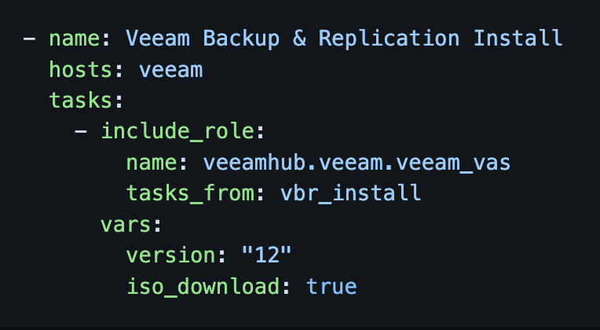
Ansible
Veeam Backup & Replication community edition install
Ansible natively supports PowerShell!
Why? Aren’t we talking about PowerShell?
Notes:
Infrastructure as code

Slide 32
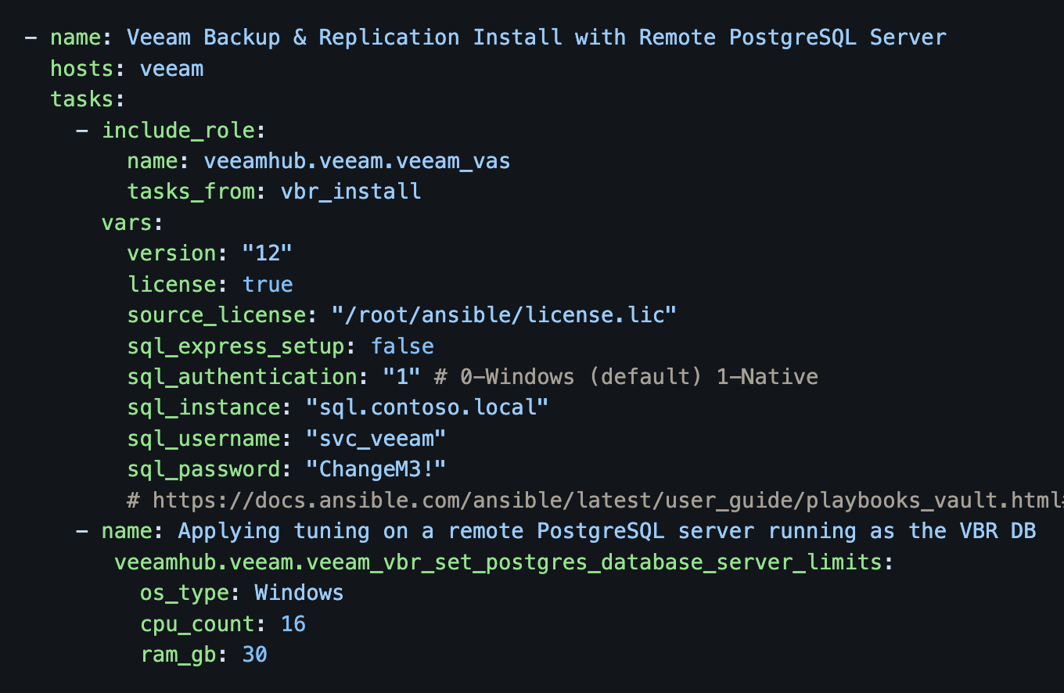
Ansible
Veeam Backup & Replication install with remote PostgreSQL

Slide 33


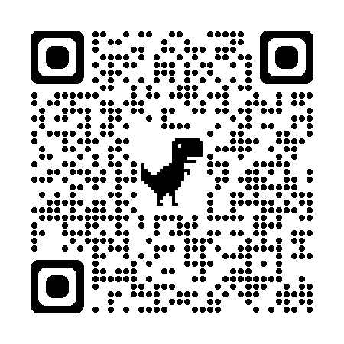
VeeamHub
Unofficial, community supported projects created by Veeam enthusiasts.
Open source
Over 200 scripts
Over 100k lines of code!
Contributions welcomed
github.com/VeeamHub

Slide 35
Section divider title
Section #
Section divider subtitle

